Slide 1
Good and Bad UI/UX in LPU Campus
Course Code:-IXD801
Subject Name:- Interaction Design
Submitted By :- Yogita Yadav Submitted to :-Ms. Maggie Gunjan Banra

Slide 2
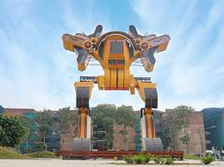
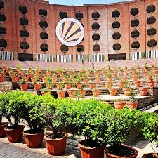
Good UI
The bright yellow color and strong, balanced shape make the robot stand out clearly.
The repeated pattern of the pots on the steps creates
a sense of rhythm and visual order.

Slide 3
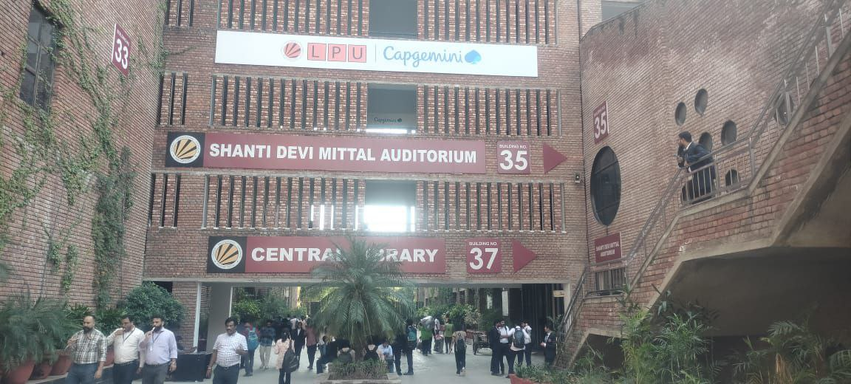
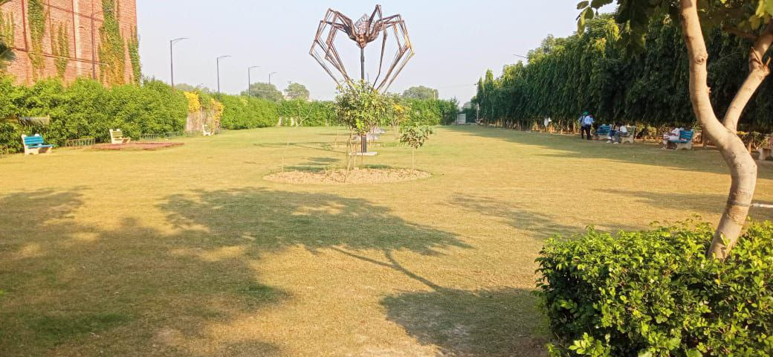
The park's thoughtful design combines open green
space for a relaxing atmosphere, benches for user
comfort, and a distinctive spider sculpture that
acts as a memorable focal point.
The sign uses large, white numbers and a clear
arrow, making it very easy to read from a
distance.

Slide 4
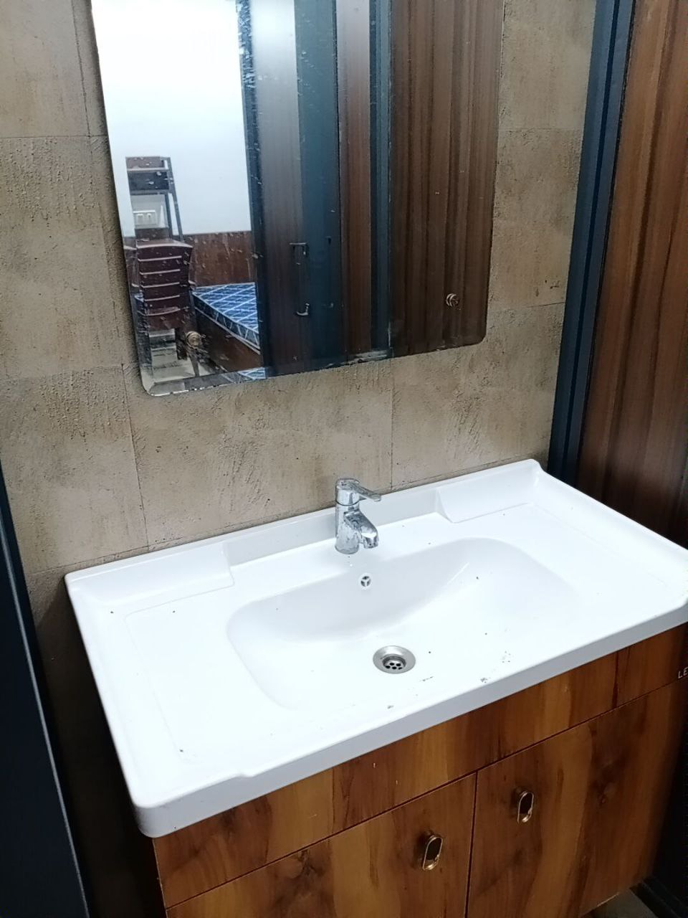
The bright white basin offers a clean visual contrast against the wood, while its wide,flat edges provide a practical and convenient surface for placing items.

Slide 5
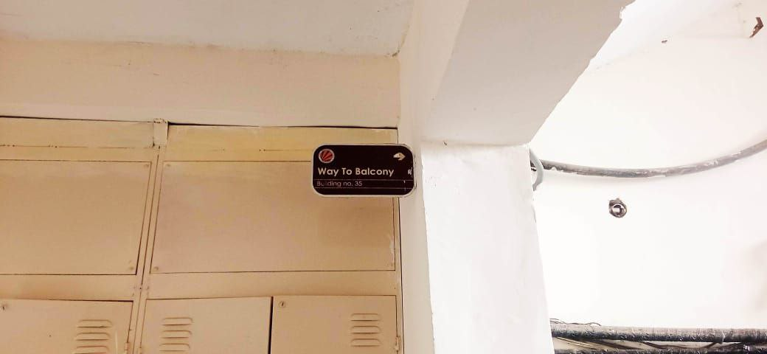
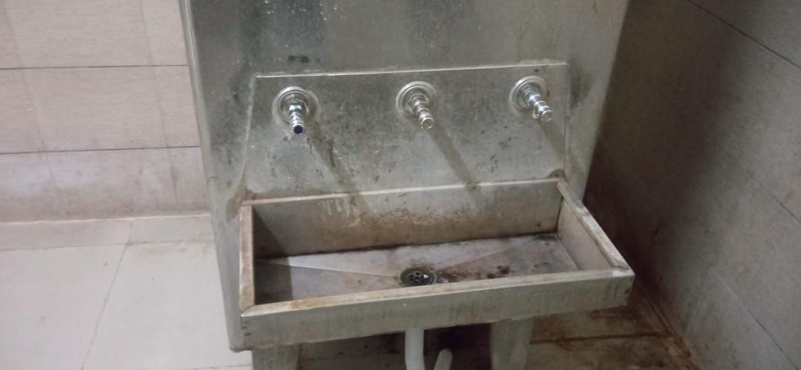
Bad UI
The sign's small size and dark color provide poor visual.
The severe lack of cleanliness and visible stains creates a strong visual "error state," making the water cooler appear unusable and untrustworthy.

Slide 6
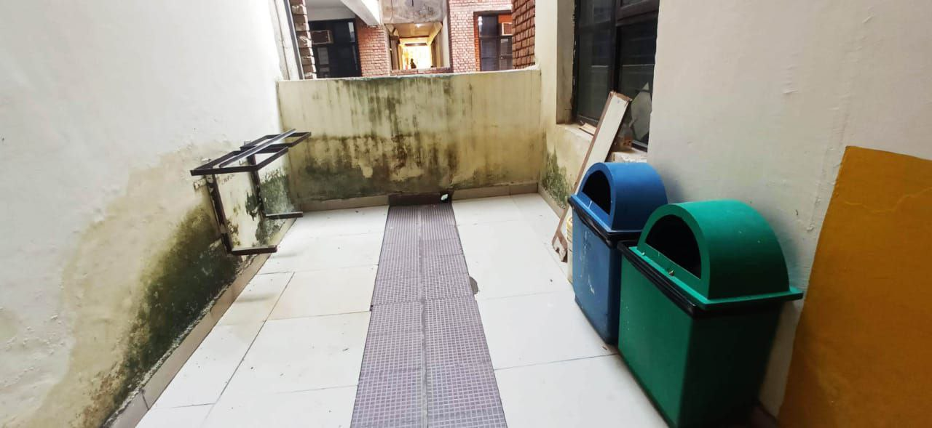
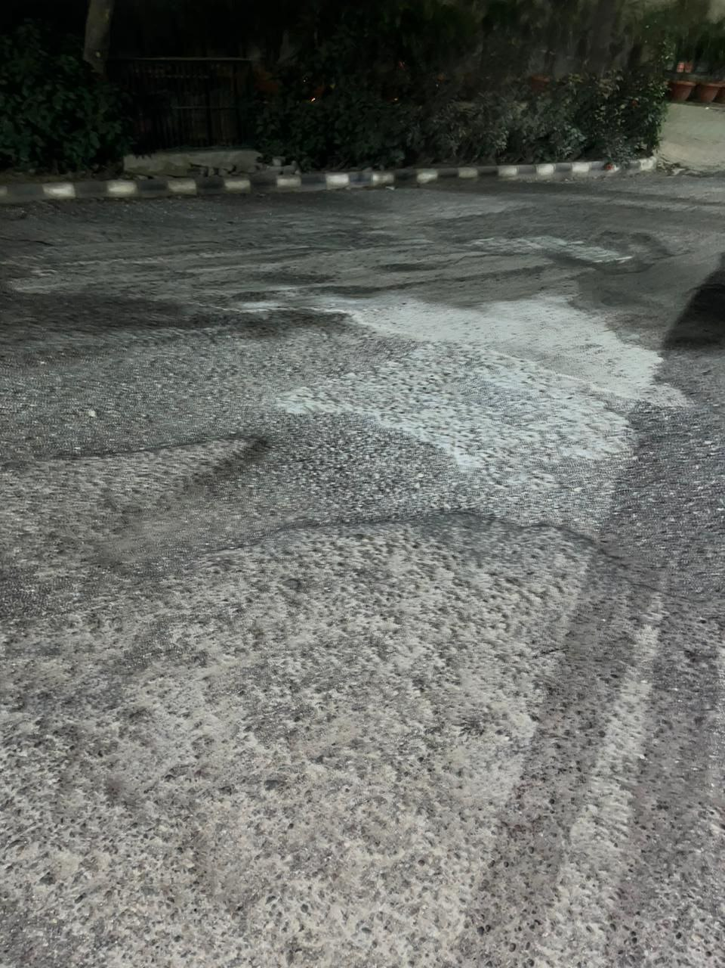
Bad UI
The severe wall decay and dampness create a bad user environment and makes the space feel unsafe and unpleasant to use.
The road's surface displays a bad texture and inconsistent, creating a visually noisy and disorganized interface.

Slide 7
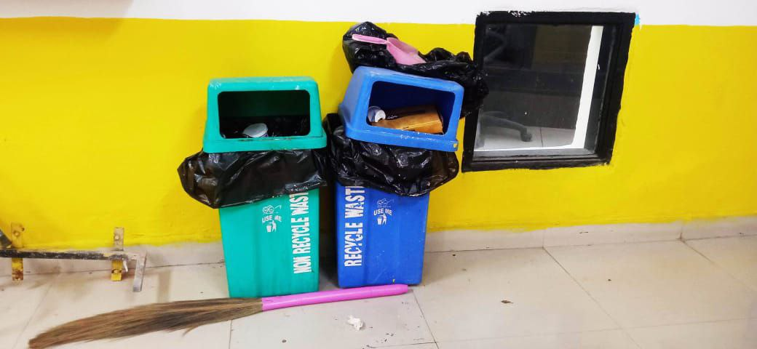
The overflowing bins indicate a system with insufficient capacity, leading to a "system crash" that makes the entire waste disposal feature unusable and messy.

Slide 8
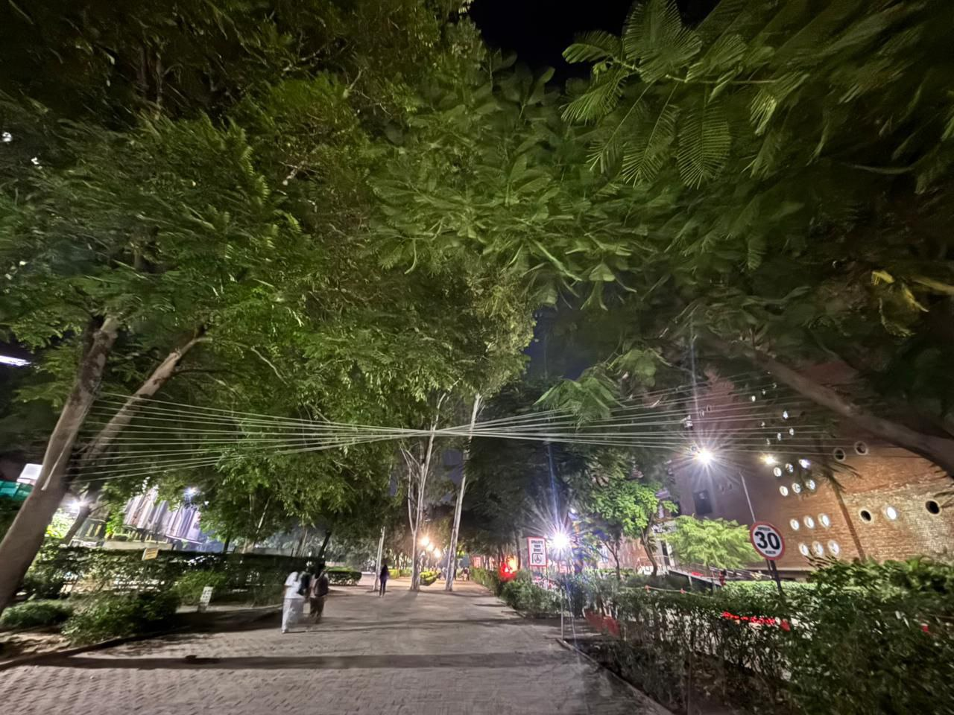
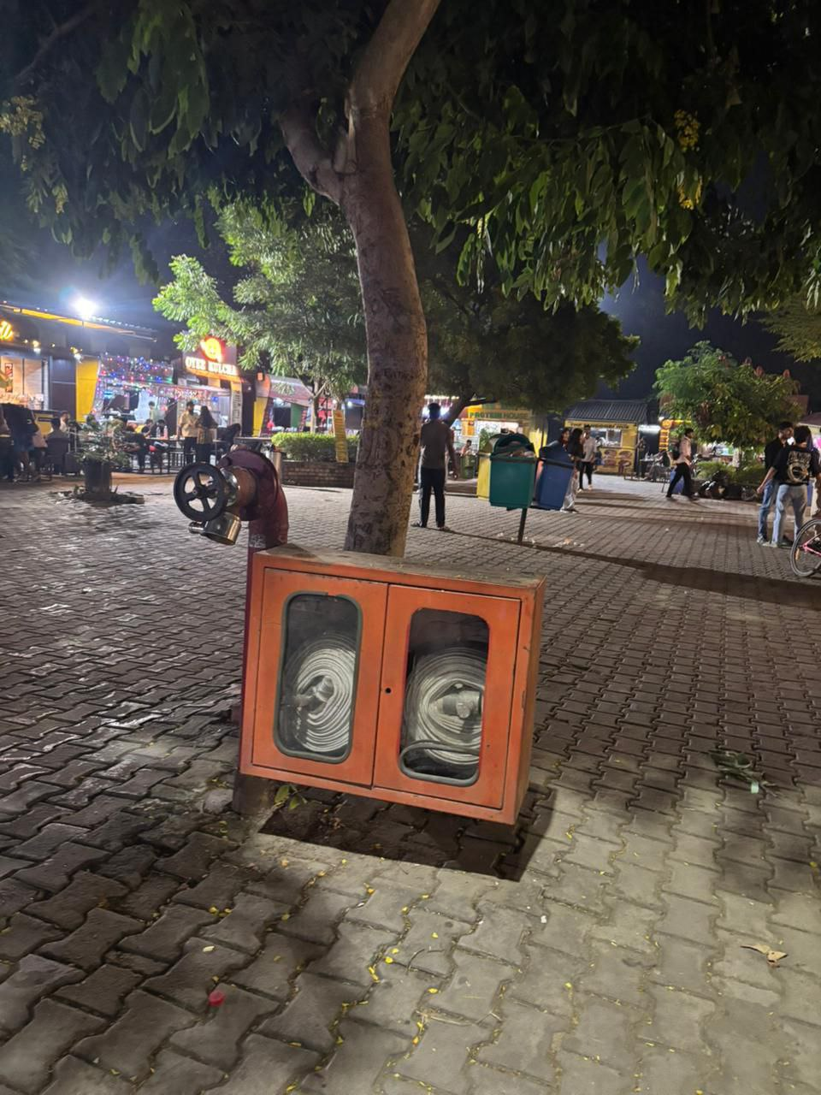
Good UX
Placing these fire safety boxes in open, easy-to-see spots
is a very smart design for safety. It means that if a fire
ever starts, help is right there and easy to find, keeping
everyone much safer.
These wires support the trees to keep them from falling
over onto the path.This makes the walkway much safer
and helps people feel secure as they walk by.

Slide 9
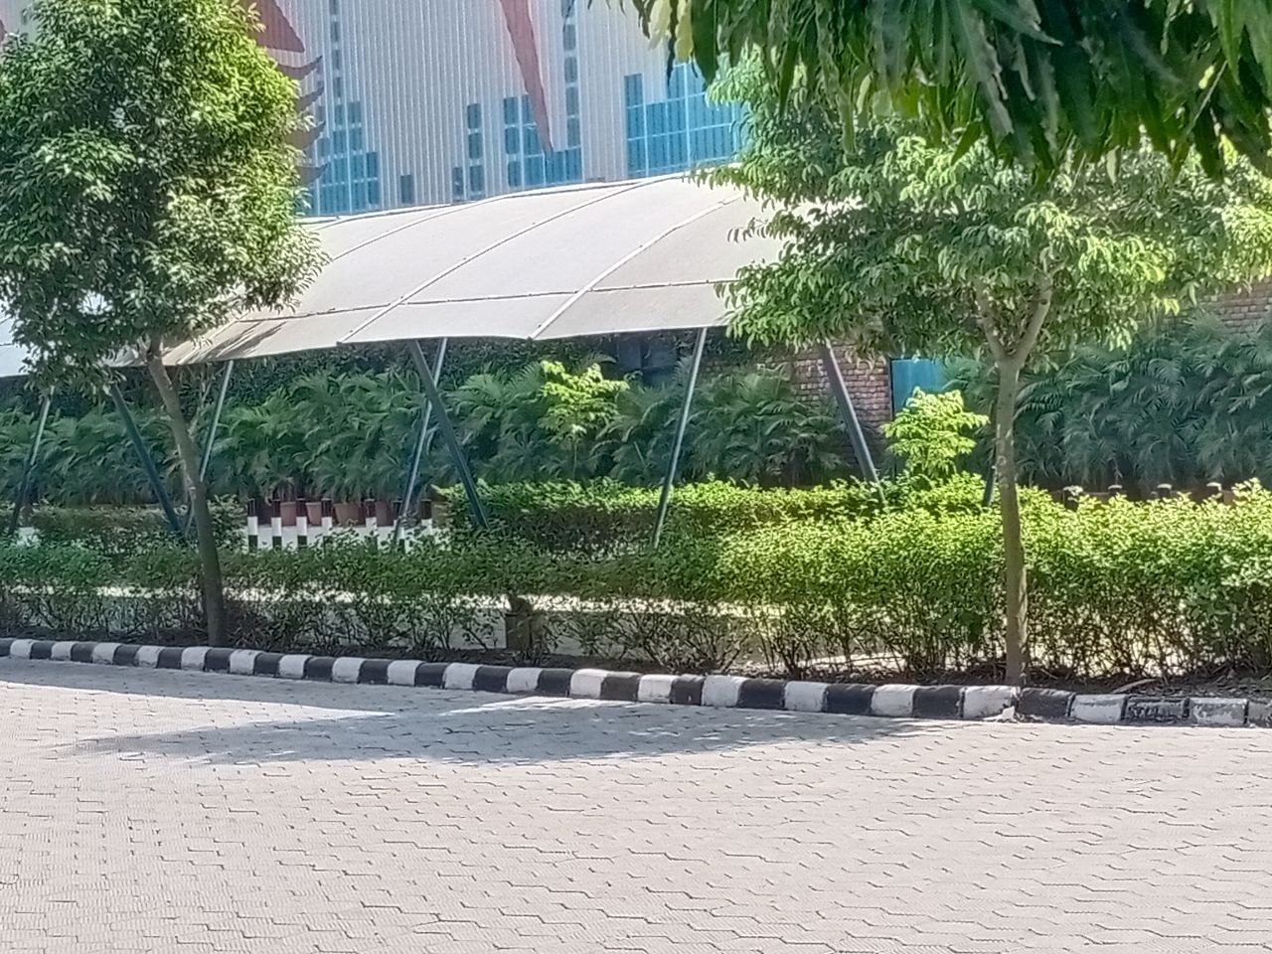
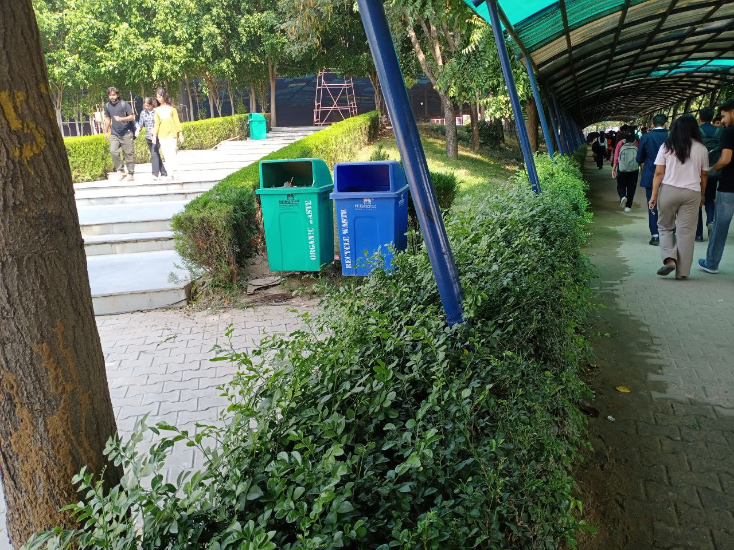
This covered walkway provides essential shade,
protecting students from the direct sun.This makes
walking across campus a much more comfortable and
pleasant experience during hot weather.
Putting dustbins in easy-to-reach spots makes it simple
for everyone to throw their garbage away properly. This
is a key reason the campus stays so clean and is a
pleasant place to walk around.

Slide 10
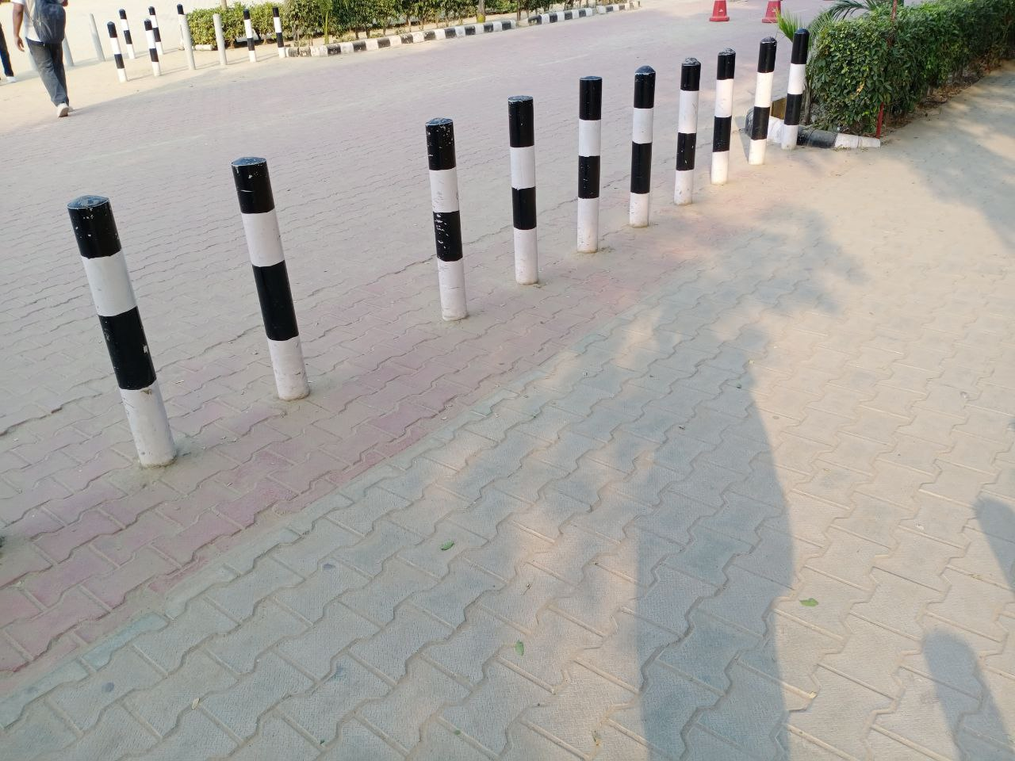
These poles create a safe barrier between the walking path and the road.This simple design protects people from traffic and clearly shows them where it is safe to walk.

Slide 11
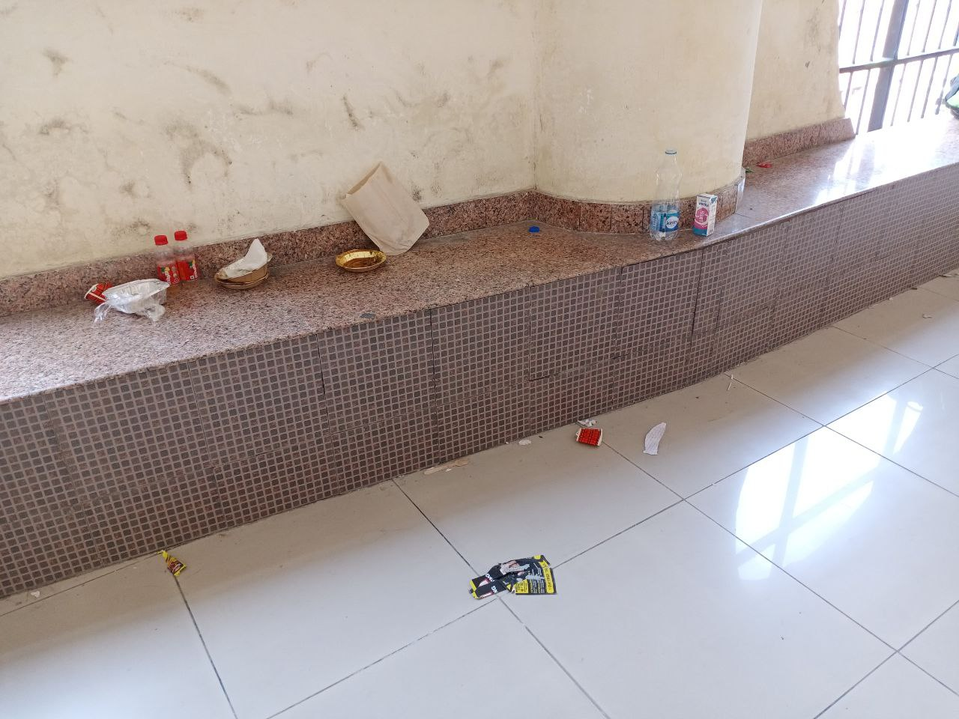
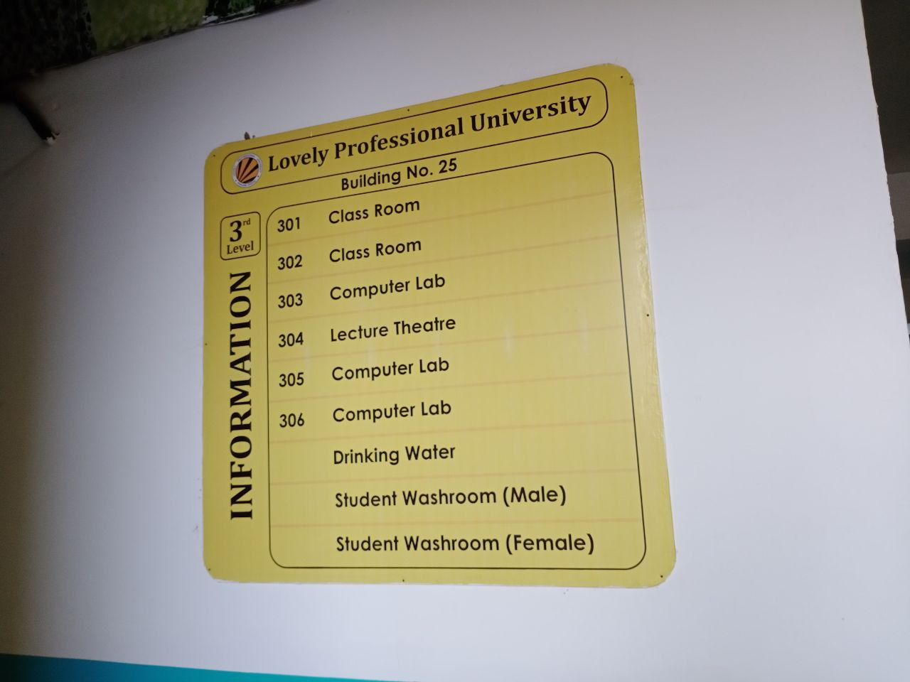
Bad UX
The garbage left on this ledge makes the seating
area dirty and useless, preventing anyone from
being able to sit down and rest.
This sign lists the rooms but gives no arrows or
directions, forcing new students to guess which
way to go and causing confusion.

Slide 12
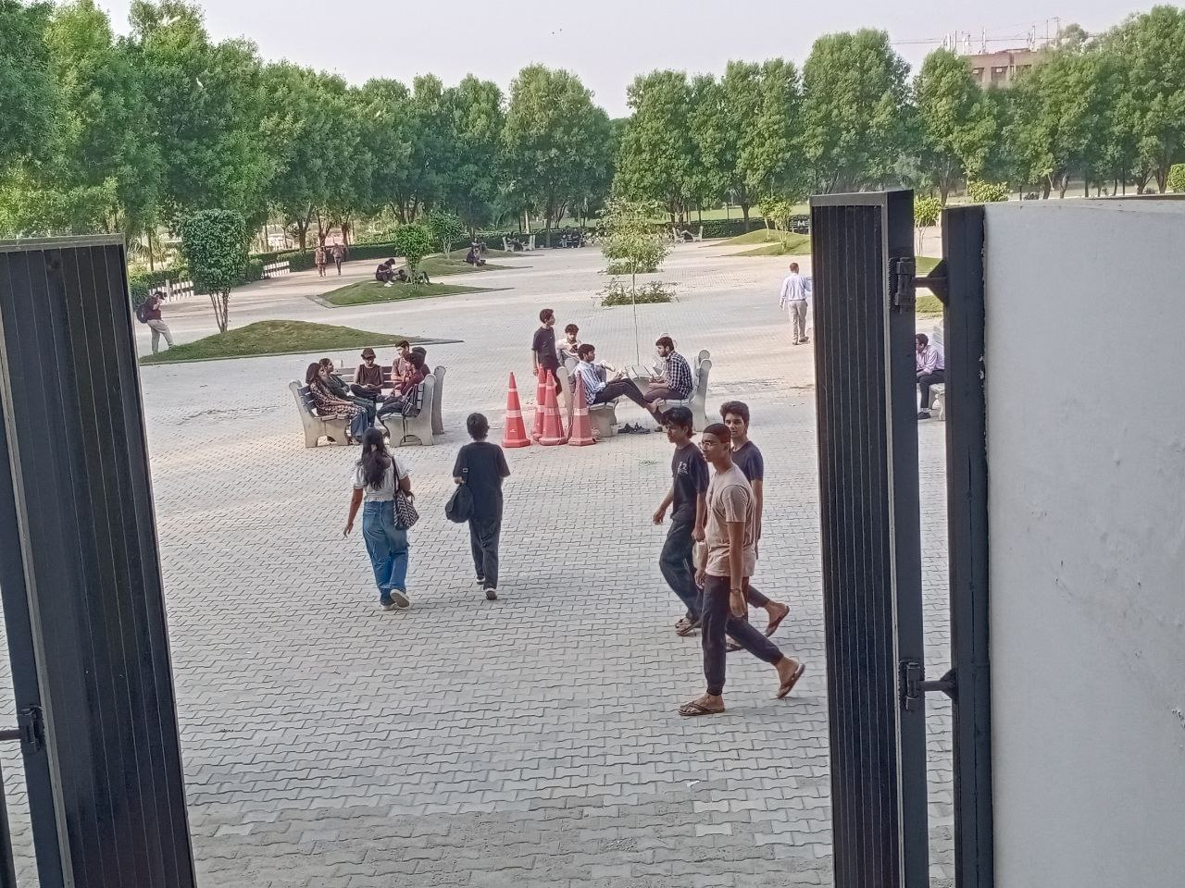
By placing the benches in the open without any shade, they become too hot and uncomfortable to use during sunny afternoons.This design fails to consider the students' basic need for comfort, making this resting area completely useless when the weather is hot.
Because the water cooler is so dirty, students don’t
trust that the water is safe to drink.This makes it
completely useless for anyone who is thirsty and
fails to provide a basic necessity.

Slide 13
Because the road is so bumpy and broken, it gives a really rough and uncomfortable ride.
This makes driving frustrating and doesn’t feel safe for anyone using it.

